Slide 1
CEPT Preparation for WRC-19
Peter Faris
European Communications Office
ITU Seminar on Radiocommunication Matters for Europe
(SRME-19)
24 June 2019

Slide 2
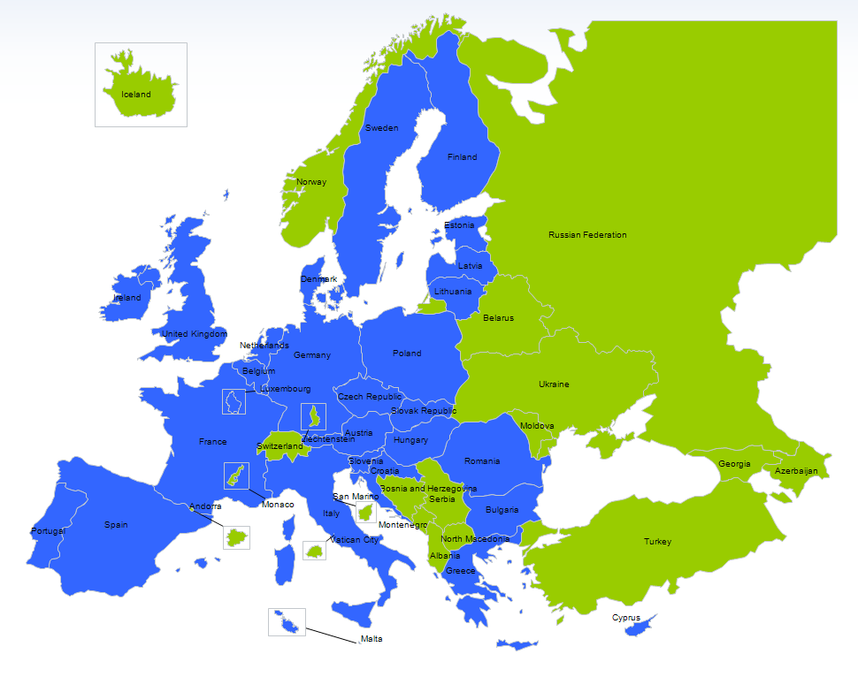
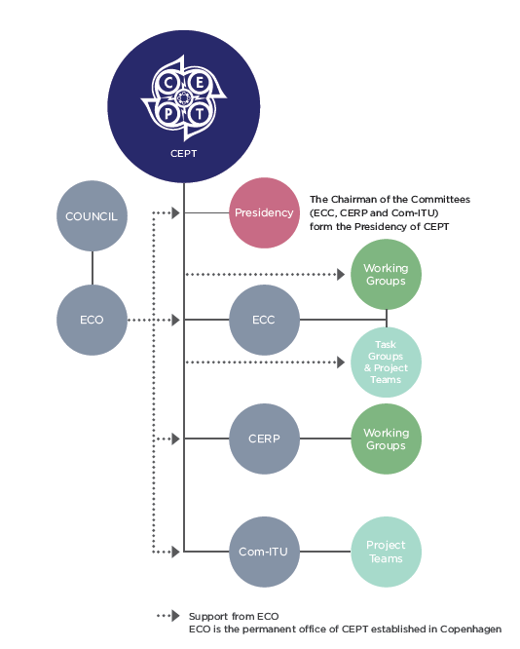
CEPT: European Conference of Postal and Telecommunications Administrations
CEPT: Organisation of regulators and policy makers from 48 European countries (including all EU Member States)
ECC: Electronic Communications Committee – main body with responsibility for spectrum and telecommunications
CPG: Conference Preparatory Group – ECC working group responsible for WRC-19 preparations
EU Member States – blue
Other CEPT members - green

Slide 3
Current status of preparation – agreed positions
CEPT has adopted European Common Proposals (ECPs) for the following WRC-19 Agenda Items:
1.2 – Earth stations at 400 MHz: support in-band limits
1.3 – EESS and MetSat at 460 MHz: support upgrade of MetSat allocation and addition of primary EESS
1.4 – BSS: support removal of some limitations
1.8 Issue A - Modernisation of GMDSS: support introduction of MF and HF frequencies
1.9.2 - VDES satellite: support new primary MMSS allocations
1.10 – GADSS: No change to RR Article 5; addition of information to RR Article 30
1.13 – IMT-2020 - Bands 31.8-33.4 GHz, 71-76 GHz, 81-86 GHz: No change
1.15 - Services above 275 GHz: Add new footnote for identification of mobile and fixed service applications
7 – Satellite procedures - Issues B, D, G, H and K: various proposals
9.1.2 – BSS Sound: support pfd limits in Regions 1 and 3 for protection of mobile service
9.1.3 - Non GSO FSS C-band: No change to RR Article 21 and 22; new coordination procedure under RR No. 9.12
9.1.5 - Protection criteria 5GHz: update of information on sharing conditions in RR footnotes 5.447F and 5.450A
9.1.6 - WPT for electric vehicles: No change
9.1.7 - Unauthorised terminals: No change
9.1.8 - Machine type communications: No change
9.2 – Inconsistencies - No. 5.441B: support retention of pfd and other technical criteria

Slide 4
Current status of preparation – positions to be finalised
ECPs for the following agenda items are still under discussion (final CPG meeting 26-30 August):
1.5 - ESIM
1.6 -Non-GSO FSS Q/V band
1.7 - Nano-/ Picosatellites - Option A
1.8 Issue B - New Satellite System for GMDSS
1.9.1 - Autonomous maritime radio devices
1.13 – IMT-2020 - Bands 26 GHz, 66-71 GHz, 40-43.5 GHz, Suppression of Res. 238
1.14 - HAPS
1.16 - RLAN at 5 GHz
2 - Incorporation by reference
4 - Review of WRC Resolutions and Recommendations
7 – Satellite procedures - Issues A and F
9.1.1 - 2GHz MSS
9.1.4 - Suborbital planes
9.1.9 - FSS 50 GHz
10 – Future Agenda for WRC-23

Slide 5
Agenda Item 1.13 – spectrum for IMT-2020 (5G)
CEPT is supporting IMT identification in the following bands:
24.25-27.5 GHz:
European pioneer band for 5G, already harmonised in CEPT (ECC Decision (18)06)
CEPT is supporting IMT identification with similar technical conditions, including limits to protect passive services below 24 GHz
40.5-43.5 GHz:
Good potential for future harmonisation in Europe
Possibility for global 5G tuning range with 37-40.5 GHz, but the lower band is not proposed for use in CEPT
66-71 GHz:
CEPT supports equal access of 5G and Multi Gigabit Wireless Systems (WiGig) in this band

Slide 6
Agenda Item 1.13 – spectrum for IMT-2020 (5G)
The following bands are not supported for 5G (No Change position):
31.8-33.4 GHz
71-76 GHz
81-86 GHz
No Change also likely to be agreed for:
47-47.2 GHz
50.4-52.6 GHz
Ongoing discussion on:
45.5 – 47 GHz: possible support for IMT identification
47.2 – 50.2 GHz: possible support for IMT identification with split of the band at 48.2 GHz

Slide 7
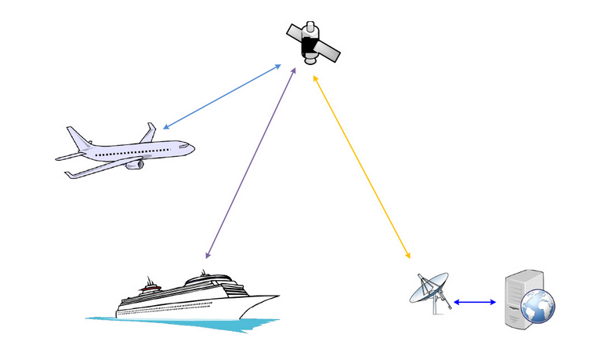
Agenda Item 1.5 – Earth Stations in Motion
Existing European regulatory framework in ECC Decision (13)01 (ESOMPS): 17.3-20.2 GHz (space-to-Earth) and 27.5-30.0 GHz (Earth-to-space)
CEPT supports a global regulatory framework for 17.7-19.7 GHz (space-to-Earth) and 27.5-29.5 GHz (Earth-to-space) in line with Res. 158 (WRC-15)
Coexistence with terrestrial services:
Transmitting ESIM (27.5-29. GHz) – specific provisions to avoid unacceptable interference
Receiving ESIM (17.7-19.7 GHz) – no protection
Coexistence with space services:
ESIM shall remain within the envelope of the satellite network with which they communicate
Specific provisions to protect non-GSO FSS systems and MSS feeder links

Slide 8
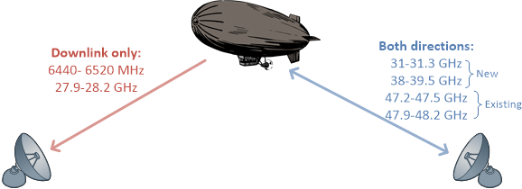
Agenda Item 1.14 – High Altitude Platform Stations
CEPT supports worldwide identification for HAPS
while protecting existing services and their development
new or modified footnotes and associated Resolution
Potential identification of 21.4-22 GHz and 24.25-27.5 GHz in Region 2:
Space services shall be protected
No constraints on the identification of the 26 GHz band for IMT at a global level under AI 1.13

Slide 9
Agenda Item 10 – Future AIs for WRC-23
CEPT position on Preliminary AIs (Resolution 810) – subject to final adoption:
2.1: GMDSS modernisation
2.2: new allocation to EESS (active) service for space-borne radar sounders around 45 MHz
2.3: space weather sensors
2.4: new allocations to fixed-satellite service in 37.5-39.5 GHz (Earth-to-space)
2.5: review the spectrum use and spectrum needs in 470-960 MHz in Region 1

Slide 10
Agenda Item 10 – Future AIs for WRC-23: draft CEPT Proposals
New allocation to the AMS(R)S in 112-137 MHz
New non-safety aeronautical mobile applications
Removal of the limitation for aeronautical mobile in the IMT bands in 694-960 MHz for new non safety applications
Review of regulatory provisions related to aeronautical terrestrial services
Technical and operational measures for stations on board sub-orbital vehicles
NGSO FSS ESIM in 17.7-18.6 (space-to-Earth), 18.8-20.2 GHz (space-to-Earth), 27.5-30.0 GHz (Earth-to-space)
Review of 18.6-18.8 GHz to address possible new FSS usage and protection of EESS (passive)
Compatibility of satellite-to-satellite links with other FSS and other services in 27.5‑30 GHz (Earth-to-space) and 17.7-20.2 GHz (space-to-Earth)
Consideration of protection of GSO satellite systems in 7/8 and 20/30 GHz from emissions of non-GSO satellite networks
Consideration of revising Resolution 155 (WRC-15) and RR No. 5.484B
Global harmonisation of 12.75-13.25 GHz by earth stations on aircraft communicating with GSO FSS (Earth-to-space)
Consideration of a new EESS (Earth-to-space) allocation in the band 22.55-23.15 GHz
Additional allocations to the mobile-satellite service between 1.5 GHz and 6 GHz
Introduction of pfd and EIRP limits in Article 21 for 71-76 GHz and 81–86 GHz, and use of these bands by satellite services ensuring compatibility with passive services
Additional allocations to the radiolocation service in 231.5 – 275 GHz, identification of bands in 275 - 700 GHz for millimetre and sub-millimetre wave imaging systems, and review of EESS (passive) in the range 231.5 – 252 GHz

Slide 11
ECC Contact | Web www.cept.org/ecc
ECO Nyropsgade 37, 4th floor DK-1602 Copenhagen Tel:+45 33 89 63 00 E eco@eco.cept.org

